Slide 1
Use of Java-DSP to Demonstrate Power Amplifier Linearization Techniques
Presenter
Robert Santucci
PI: Dr. Andreas Spanias

Slide 2
Overview
Objectives
Introduce the Problem
Design Tradeoffs
New Java-DSP Predistortion Modules
  PA Linearized by Gain-based LUT
  PA Linearized by Neural Networks
Conclusions

Slide 3
Objective
Use Java-DSP to construct a set of tutorials illustrating design tradeoffs between the communications, DSP, and RF domain when designing a wireless transmitter
Familiarize students with the metrics used to quantify performance in a wireless transmitter
Allow students to experiment with design choices and assess their impact on performance.

Slide 4
Wireless Signals
Modern Smartphones, YouTube, Web Browsing
  Demand higher data rate than old voice service
Bandwidth is expensive and fixed
  Need to modulate both amplitude and phase to make most efficient use of spectrum
Symbols are generally transmitted at a faster rate
Fast symbol Tx in an uncontrolled results in unpredictable multipath
  Solution: Transmit many bits in parallel very slowly using adjacent frequencies. -- OFDM

Slide 5
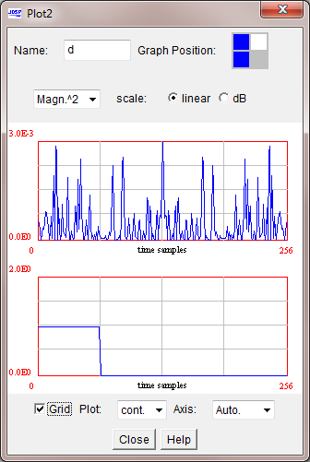
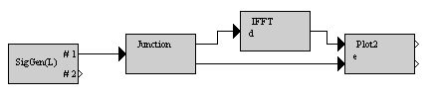
Is OFDM the answer?
For mitigating multipath? Yes, it can work well.
What does the signal look like in time and frequency?
  Build a schematic in JDSP.
  Select OFDM 4x OSR as input signal
  Here we can see that the average
  power transmitted changes rapidly

Slide 6
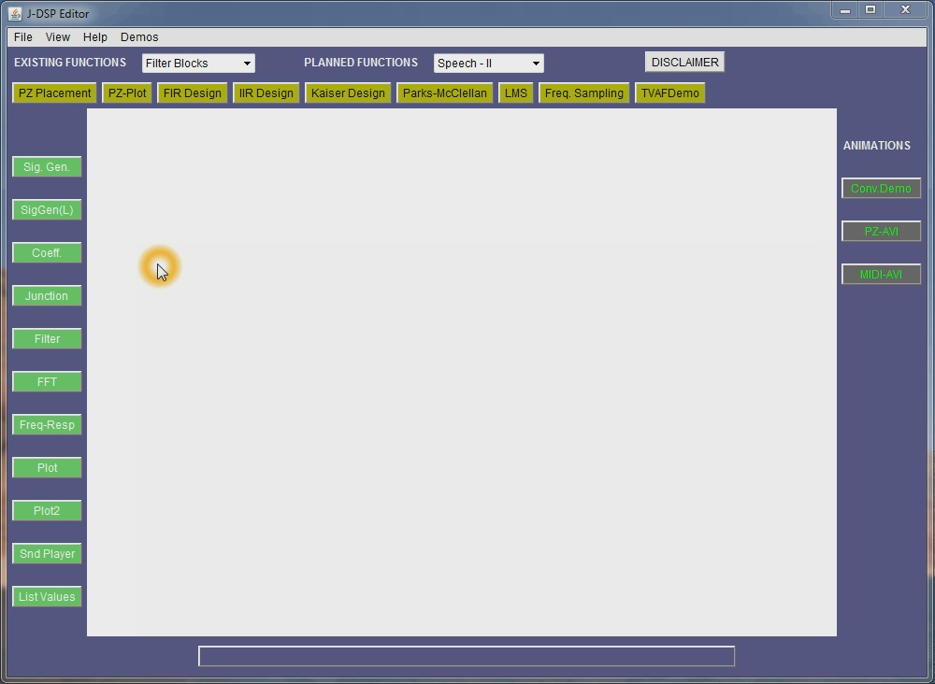
OFDM Java-DSP Demo

Slide 7
PA Ramifications
Large variation in signal amplitude against time
Peak-to-Average Power Ratio (PAR)
To avoid distorting the signal, amplifier must be linear across the entire dynamic range.
A fundamental tradeoff exists between amplifier efficiency and linear range exists.
  Want to drive the amplifier to its peak output power to get maximum efficiency
  When the amplifier is near peak output power output compresses and produces distortion just like in your car

Slide 8
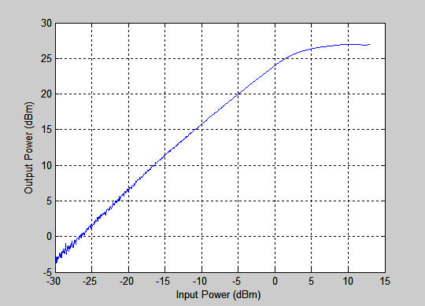
Amplifier Compression
Amplifier becomes a non-constant multiplier, convolves with the signal to be transmitted causing distortion.
This compression, or clipping, is discussed in our previous work [1].
We’d like to develop a
technique to operate the
amplifier deep into this
compressed region to
boost overall
transmitter efficiency.

Slide 9
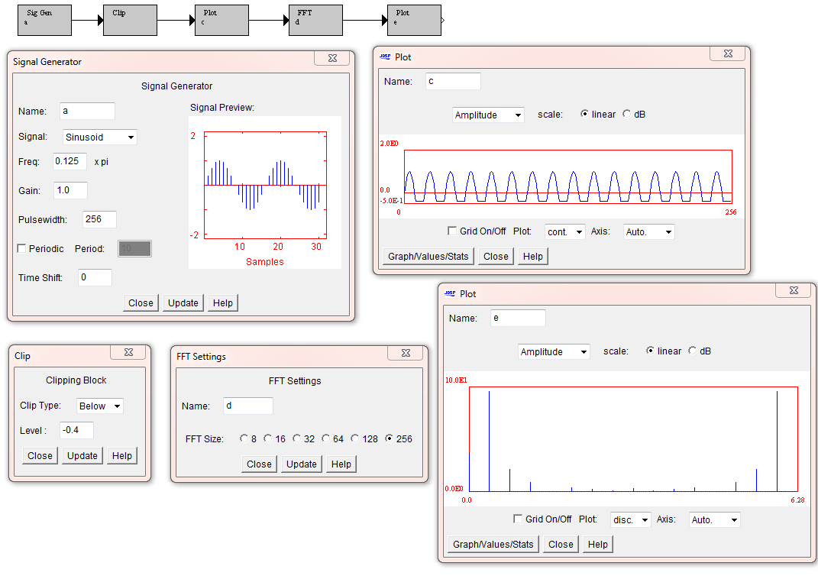
Clipping Demo
Can also demonstrate coherent sampling
Alter input signal level or clipping level to see change in fundamental and harmonic energy. Note: Fundamental gain decreases with input

Slide 10
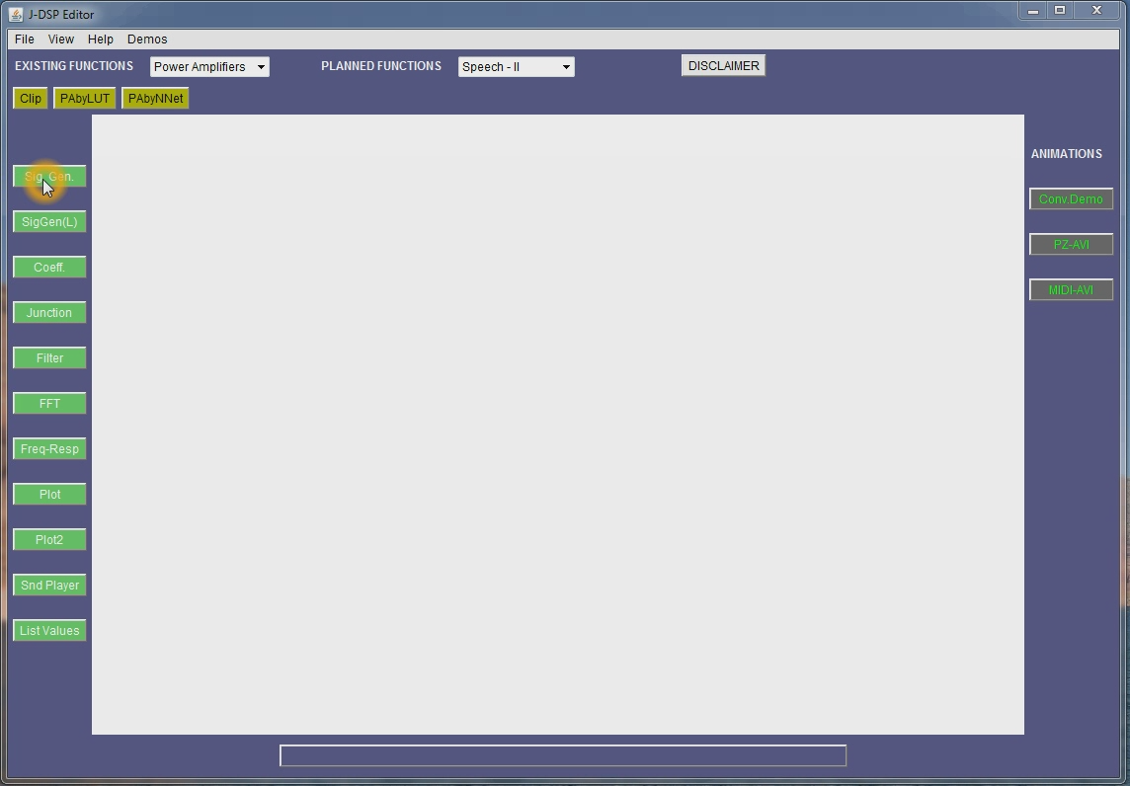
Java-DSP Clipping

Slide 11
Performance Metrics
Adjacent Channel Power Ratio (ACPR)
  Ratio of the amount of power leaked into adjacent bands compared to power in the intended band
Error Vector Magnitude (EVM)
  Ratio of the power between the error power away from the intended signal and the intended signal power within the band.

Slide 12
Gain-Based LUT
Split the gain curve into regions and correct each region’s gain via an adaptive algorithm [1]
LMS:
$$b_{selected}\left(n+1\right)=b_{selected}\left(n\right)+2μe\left(n\right) v_{in}^{∗}(n)$$
[1] Cavers, J.K., "A linearizing predistorter with fast adaptation," Vehicular Technology Conference, 1990 IEEE 40th , vol., no., pp.41-47, 6-9 May 1990.

Slide 13
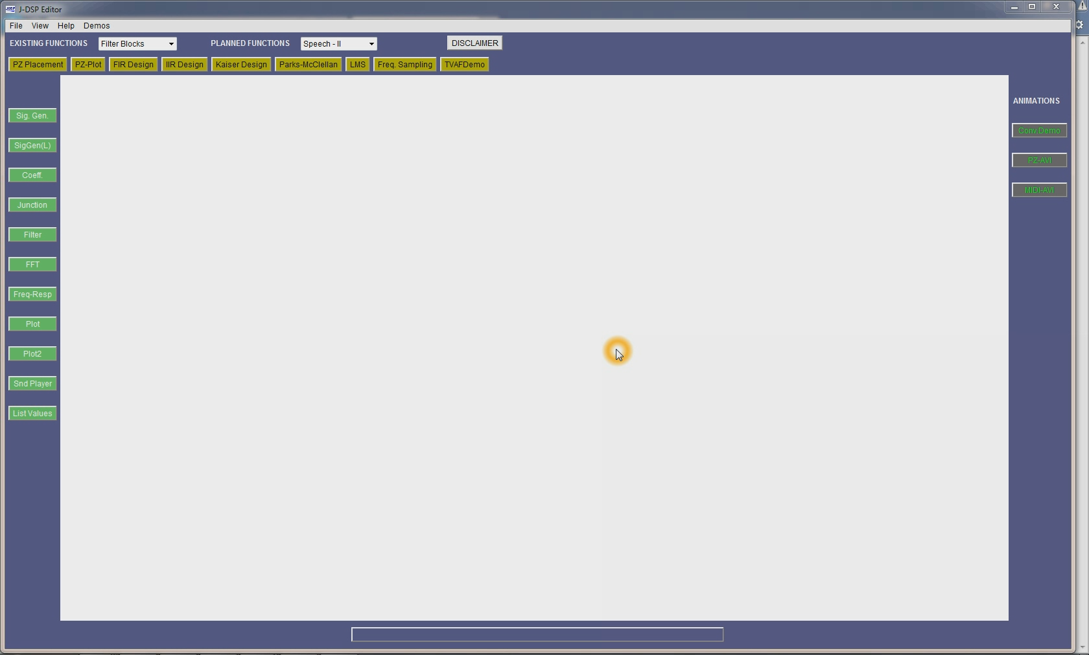
PD by LUT Demo

Slide 14
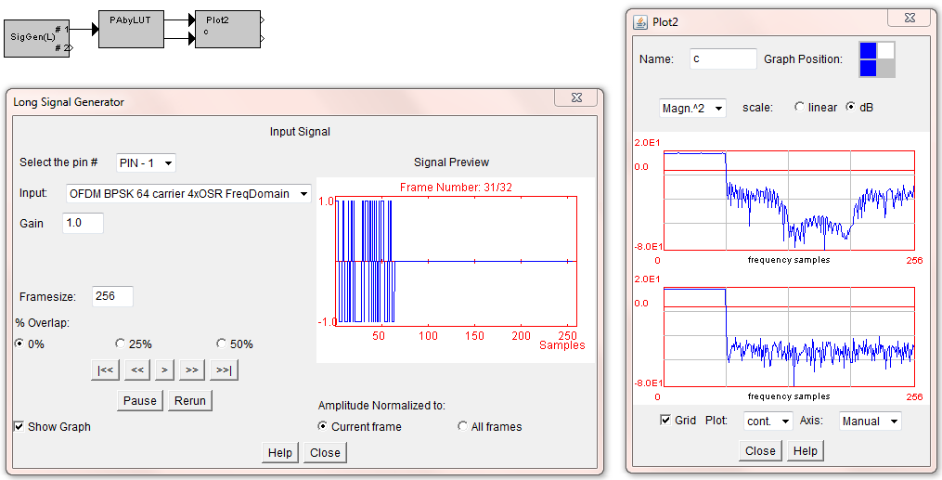
PD by LUT Schematic

Slide 15
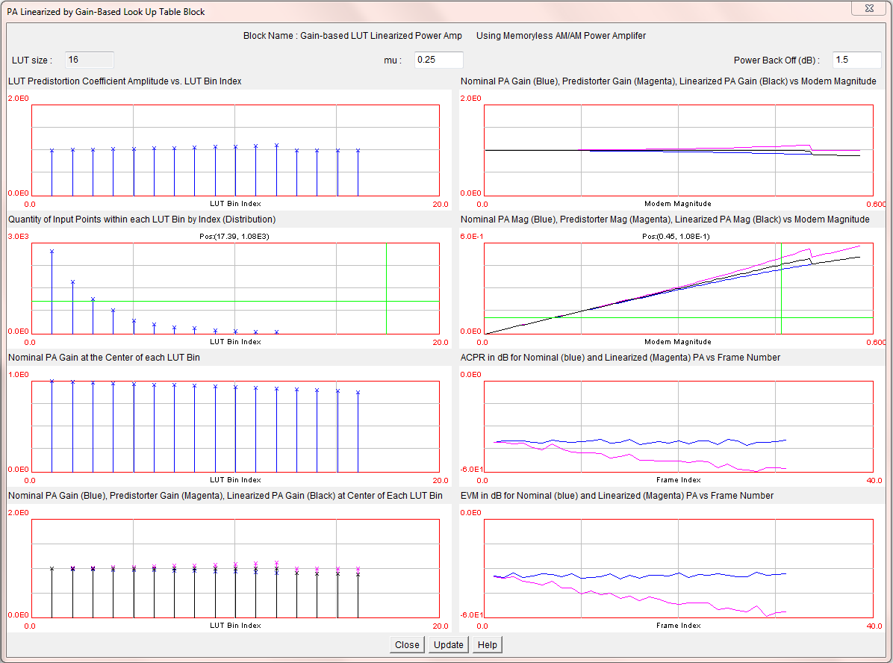
Predistorter Block

Slide 16
Predistorter Block
Magnitude of Gain Factor in each LUT bin
Histogram of points within each LUT bin
Nominal Power Amplifier Gain in Each bin
PA Gain Nominal (Blue)
Linearizer Gain (Magenta)
Net System Gain (Black)
at the center of each bin.

Slide 17
Predistorter Block
Nominal PA Gain (Blue)
Predistorter Gain (Magenta)
Linearized PD+PA Gain (Black)
Nominal PA Magnitude (Blue)
Predistorter Magnitude (Magenta)
Linearized PD+PA Gain (Black)
ACPR Nominal (Blue)
ACPR with Predistortion (Magenta)
EVM Nominal (Blue)
EVM with Predistortion (Magenta)

Slide 18
LUT Weaknesses
No inherent ability to compensate for non-linear distortion. Rather you are splitting the output into regions of “nearly linear” data and correct the gain for each region.
When power amplifier has memory, you can train an FIR for each bin, but the number of parameters gets very large.
Can we build a system that inherently can compensate non-linear behavior?

Slide 19
Neural Network PD
Neural networks are interconnection of multiple neurons.
Each neuron takes a weighted sum of inputs and passes it through a non-linear activation function.
Each red arrow is weight to be trained using Levenberg-Marquardt back propagation
Want to train the neural network to estimate the inverse function of the PA except for desired gain [2]. Training input data: PA output/Gain; Training target data: PA input
[2] Mkadem, Farouk; Ayed, Morsi B.; Boumaiza, Slim; Wood, John; Aaen, Peter; "Behavioral modeling and digital predistortion of Power Amplifiers with memory using Two Hidden Layers Artificial Neural Networks," Microwave Symposium Digest (MTT), 2010 IEEE MTT-S International , pp.656-659, 23-28 May 2010.

Slide 20
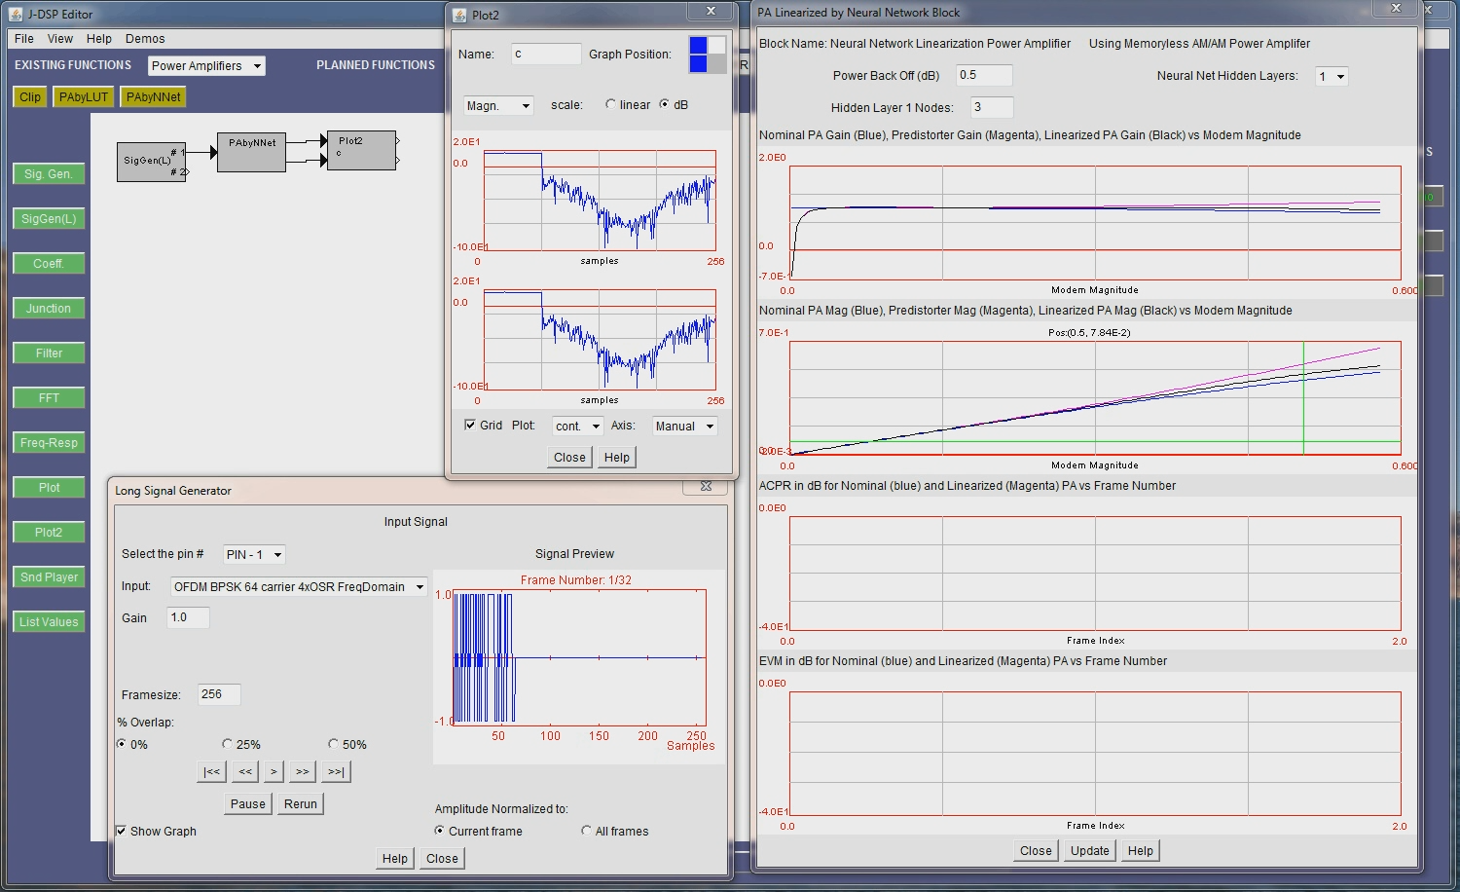
Neural Network PD Demo

Slide 21
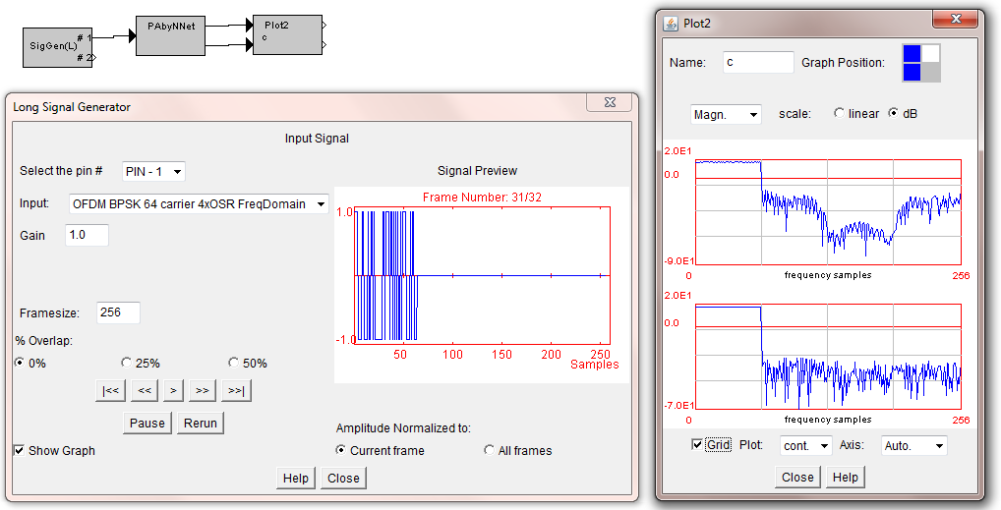
Neural Net TB Demo

Slide 22
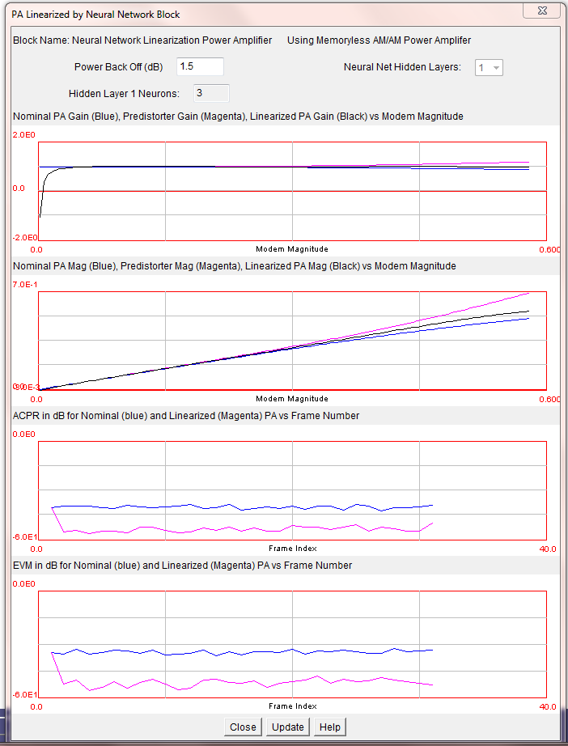
Neural Net Demo
Nominal PA Gain (Blue)
Predistorter Gain (Magenta)
Linearized PD+PA Gain (Black)
Nominal PA Magnitude (Blue)
Predistorter Magnitude (Magenta)
Linearized PD+PA Gain (Black)
ACPR Nominal (Blue)
ACPR with Predistortion (Magenta)
EVM Nominal (Blue)
EVM with Predistortion (Magenta)

Slide 23
Conclusions
Java-DSP can be used to familiarize students with advanced concepts and design tradeoffs involved in transceiver design
The modules provided allow students to experiment with the affects of parameter values without having to implement the significantly complex design underneath the simulator.

Slide 24
References
Conference papers
  [1] Santucci, R; Gupta, T.; Shah, M.; Spanias, A., “Advanced functions of Java-DSP for use in electrical and computer engineering courses,” ASEE 2010, Louisville, KY, 2010.
  Santucci, R; Spanias, A., “Use of Java-DSP to Demonstrate Power Amplifier Linearization Techniques,” ASEE 2010, Vancouver, BC, 2011.
  Santucci, R.; Spanias, A., “A block adaptive predistortion algorithm for transceivers with long transmit-receive latency,” 2010 4th International Symposium on Communications, Control and Signal Processing (ISCCSP), 3-5 March 2010.
  Santucci, R.; Spanias, A., “Block Adaptive and Neural Network Based Digital Predistortion and Power Amplifier Performance,” 2011 IASTED Signal Processing, Pattern Recognition, and Applications Conference, Innsbruck, Austria, 2011.

Slide 25


Acknowledgements
National Science Foundation
  Grant 0817596
SenSIP Center
  School of ECEE
  Arizona State University

Slide 26
Contact
Address all Communications to:
Andreas Spanias
SenSIP, School of ECEE
Rm GWC 440, Box 5706
Arizona State University
Tempe AZ 85287-5706
(480) 965 1837
sensip@asu.edu

